Slide 1
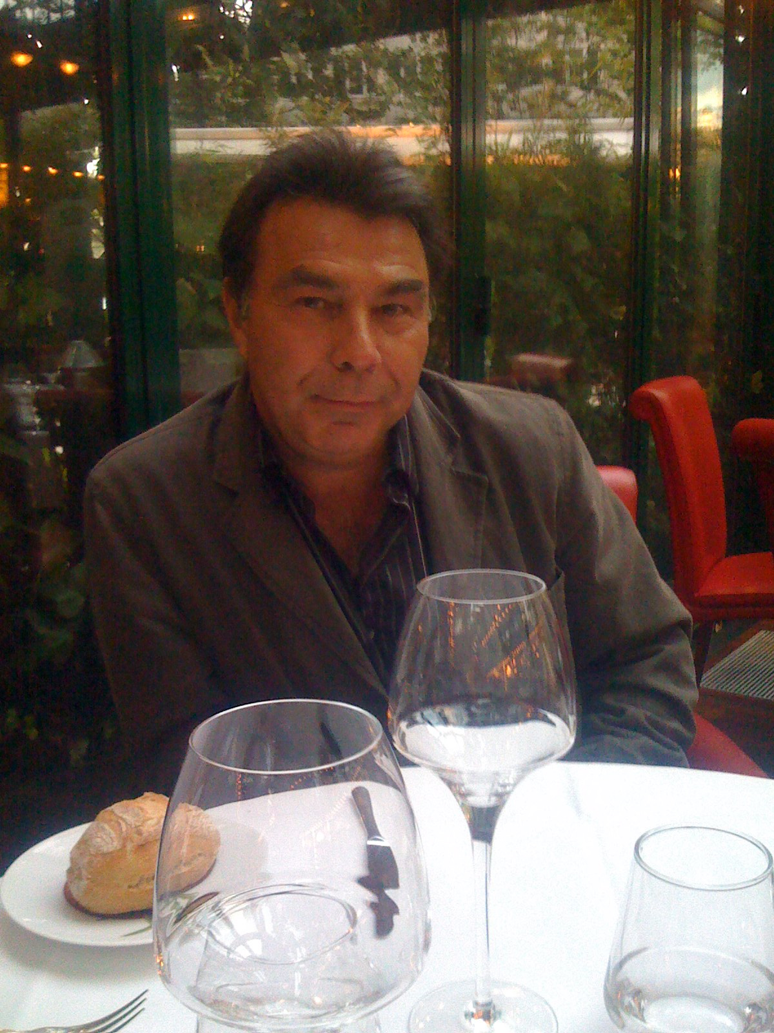
Directed acyclic graphs with the unique dipath property
J.-C. Bermond, M. Cosnard, S. Perennes Inria and CNRS
For ERIC – Happy 60th Birthday

Slide 2
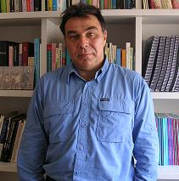
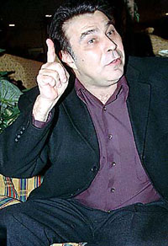

Slide 3
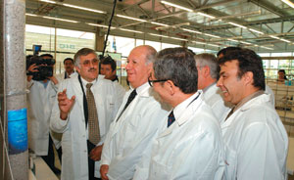
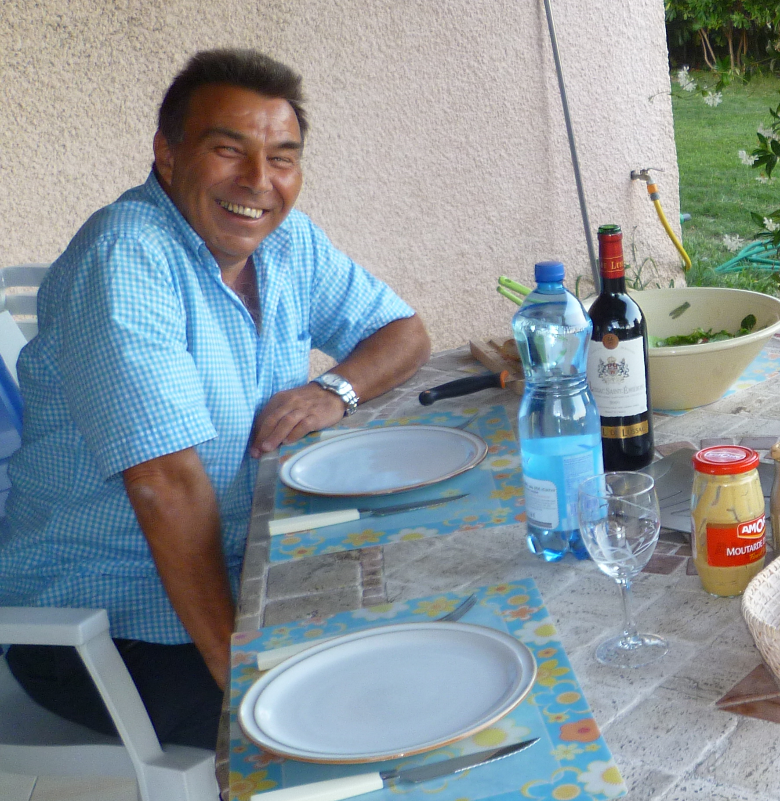

Slide 4
Introduction
Routing, wavelength assignment and grooming in optical
networks.
Generic problem : satisfy a family of requests (or a traffic
matrix) under capacity constraints request
Objectives :
Minimize the load of the routing (number of paths sharing an edge)
Minimize the number of wavelengths (two dipaths sharing an arc have to be assigned different wavelengths)

Slide 5
Introduction
minimum wavelength number >= minimum routing load
Minimizing the load or the number of wavelengths is a
difficult problem (NP-hard).
min wave number = min routing load if
General graph and multicast
Symmetric tree and all to all
Even in the case of a family of dipaths, min wave number is NP-hard (= chromatic number of the conflict graph).

Slide 6
Introduction
For directed trees and any sets of requests (family of digraphs), it can be shown that
min wave numb = min routing load
Can this result be generalized to arbitrary Directed Acyclic Graphs ?

Slide 7
A pathological example
S1
T4
S2
T3
S3
T2
S4
T1
Requests : (S1,T1), (S2,T2), (S3,T3), (S4,T4)
Minimum load = 2 : each path will cross at least another one
Minimum number of wavelengths = 4 : each path will
cross all the other paths.

Slide 8
A pathological example
S1
T4
S2
T3
S3
T2
S4
T1
Requests : (S1,T1), (S2,T2), (S3,T3), (S4,T4)

Slide 9
A pathological example
S1
T4
S2
T3
S3
T2
S4
T1
Requests : (S1,T1), (S2,T2), (S3,T3), (S4,T4)

Slide 10
A pathological example
S1
T4
S2
T3
S3
T2
S4
T1
Requests : (S1,T1), (S2,T2), (S3,T3), (S4,T4)

Slide 11
A pathological example
S1
T4
S2
T3
S3
T2
S4
T1
Requests : (S1,T1), (S2,T2), (S3,T3), (S4,T4)
min load = 2 and min number wavelengths = 4.
Can be generalized to
min load = 2 and min number wavelengths = n.

Slide 12
Definitions
A DAG (Directed Acyclic Graph) is a digraph with no directed cycle.
An (oriented) cycle in a DAG consists of a sequence of dipaths P1, P2, . . ., P2k alternating in direction
An internal cycle of a DAG G is an oriented cycle such that no vertex is a source or a sink.
S1
T4
S2
T3
S3
T2
S4
T1

Slide 13
Definitions
Given a digraph G and a family of dipaths P, the load of an arc e is the number of dipaths of the family containing e
load(G,P, e) = |{P : P ∈ P; e ∈ P}|
The load of G for P π(G,P) is the maximum over all the arcs of G.
Two dipaths are in conflict (or intersect) if they share an arc.
w(G,P) is the minimum number of colors needed to color the dipaths of P in such a way that two dipaths in conflict have different colors.
π(G,P) ≤ w(G,P).

Slide 14
Definitions and properties
The conflict graph of (G,P) is a graph whose vertices are the dipaths of P, two vertices being joined if their associated dipaths are in conflict.
w is the chromatic number of the conflict graph
π is upper bounded by the clique number of the conflict graph.

Slide 15
Problems
Consider a simplified problem : unique routing. Can we solve the problem of finding the minimum number of wavelenths ?
The answer is unknown (pathological example).
Given a DAG G and a family of dipaths P, what is the relation between the load of G for P and the minimum number of wavelenths ?
Is it possible to characterize the DAGs for which load is equal to the min wave numb ?

Slide 16
Main result
Theorem 1
Let G be a DAG. Then, for any family of dipaths P, w(G,P) = π(G,P) if and only if G does not contain an internal cycle.
Theorem 2
If a DAG G contains an internal cycle there exists a set P of dipaths such that
π(G,P) = 2 and w(G,P) = 3.

Slide 17
Unique path property DAG
Definition
A DAG has the UP Property if between two vertices there is at most one dipath. A digraph satisfying this property will be called an UPP-DAG.
Property
If G is an UPP-DAG and if a set of dipaths are
pairwise in conflict, then their intersection is a dipath (Helly property). Hence the load is the clique number of the conflict graph.

Slide 18
Unique path property DAG
Theorem 3
Let G be an UPP-DAG with only one internal cycle. Then for any family of dipaths P,
w(G,P) ≤ ceiling (4/3 π(G,P))
If C is the number of internal cycles of the
UPP-graph, then
w(G,P) ≤ ceiling ((4/3)^{C} π(G,P))

Slide 19
Unique path property DAG
Theorem 4
There exists an UPP-DAG with only one internal cycle and an infinite family of dipaths P such that :
w(G,P) = ceiling (4/3 π(G,P))

Slide 20
Unique path property DAG
Proof : w(G,P) = ceiling (4/3 π(G,P))
A1
A’1
A2
A’2
A1
A’1
A2
A’2
B1
B2
B1
B2
C1
C2
C1
C2
D1
D’1
D2
D’2
D1
D’2
D’1
D2
Dipaths : (A1B1C1D1), (A1B1C2D2), (A2B2C2D2),
(A2B2C1D’1), (A’1B1C1D’1), (A’1B1C2D’2), (A’2B2C2D’2), (A’2B2C1D1)

Slide 21
Unique path property DAG
Proof : conflict graph
A1B1C1D1
A1
A’1
A2
A’2
A’2B2C1D1
A1B1C2D2
B1
B2
A’2B2C2D’2
A2B2C2D2
C1
C2
A’1B1C2D’2
A2B2C1D’1
A’1B1C1D’1
D1
D’1
D2
D’2
If one copy of each dipath π(G,P) = 2 ; w(G,P) = 3
If k copies : π(G,P) = 2k ; w(G,P) = ceiling(8k/3)

Slide 22
Good edge-labelling
Edge-labelling: function Φ : E(G) ➔ R.
A path is increasing if the sequence of its edges labels is non-decreasing.
An edge-labelling of G is good if, for any two distinct vertices u, v, there is at most one increasing (u,v)-path.
2
a
3
b
a
b
1
3
1
2
4
4
c
d
c
d

Slide 23
UPP DAGs with load 2
Theorem 5
G UPP DAG with load 2. For any family of dipaths P, the conflict graph C(G;P) has a good labeling.
H graph with a good labeling. There exists an UPP DAG G with load 2 and a family of dipaths P such that H = C(G;P).

Slide 24
UPP DAGs with load 2
Theorem 6
There exist a family of graphs with a good labeling and an arbitrary large chromatic number.
There exist UPP digraphs with load 2 and arbitrary large w.

Slide 25
Open Problems
Let G be an undirected graph. Is it possible to orient its edges to obtain an UPP DAG ?
Bounds in terms of number of internal cycles ?
Characterisation of graphs with good labeling (decision problem NP hard (Araujo, Cohen, Giroire,Havet))
UPP DAGS with load 3 or more ??
When w = π ?

